Slide 1
DCAITI-Projekt: Fast Analysis of image collection
Yiwei Diao yiwei.diao@campus.tu-berlin.de
Yilei Chen yilei.chen@campus.tu-berlin.de
Betreuer: Jens Pontow

Slide 2
Agenda
Project Topic
Project Progression
3 Tools: fastdup, imagededup, and fiftyone
Kmeans
Current Status
Download Images
Separate Images
Define Parameters and Weights
Rank based on Cluster Priority and Score
Outlook
Download Images
Separate Images
Define Parameters and Weights
DCAITI -Projekt
‹#›

Slide 3
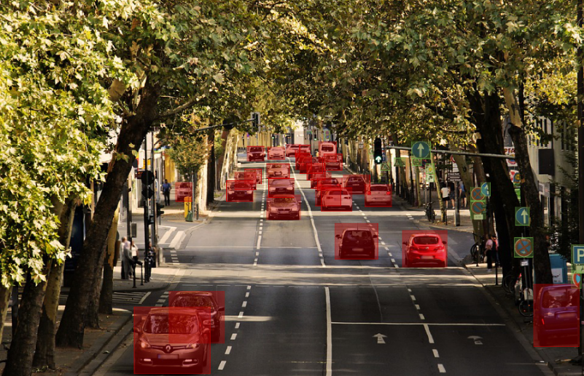
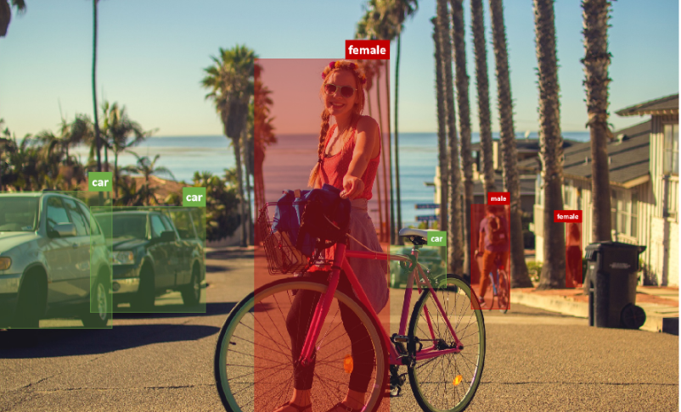
Ⅰ. Project Topic
i. Motivation
NN
Image annotation
Time-consuming, manual efforts
- Figure out which kind of images should be labeled first to
achieve better training results
Bad data:
duplicate or very identical images
outlier
etc.
Save time and manual efforts during image annotation.
Cleansing the dataset electing the good data for better fitting the model.
https://zhuanlan.zhihu.com/p/376191407
DCAITI -Projekt
‹#›

Slide 4
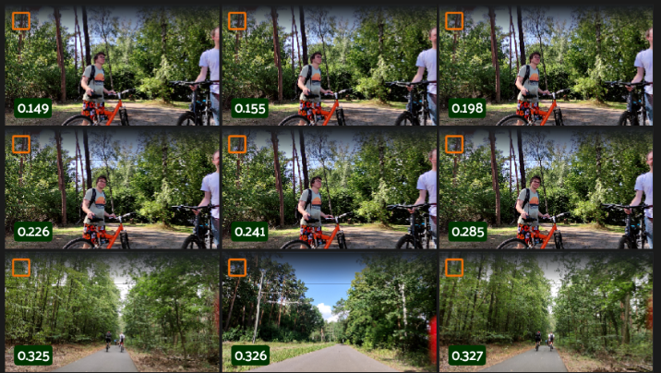
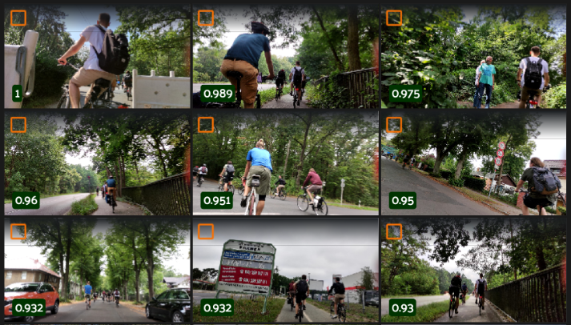
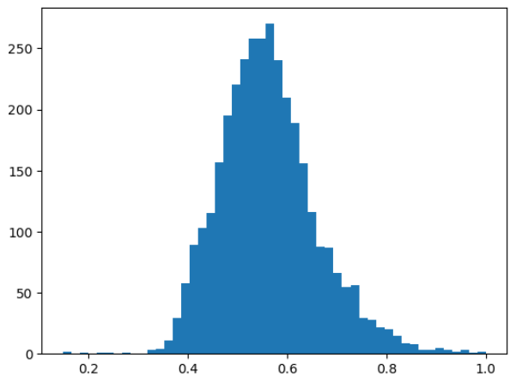
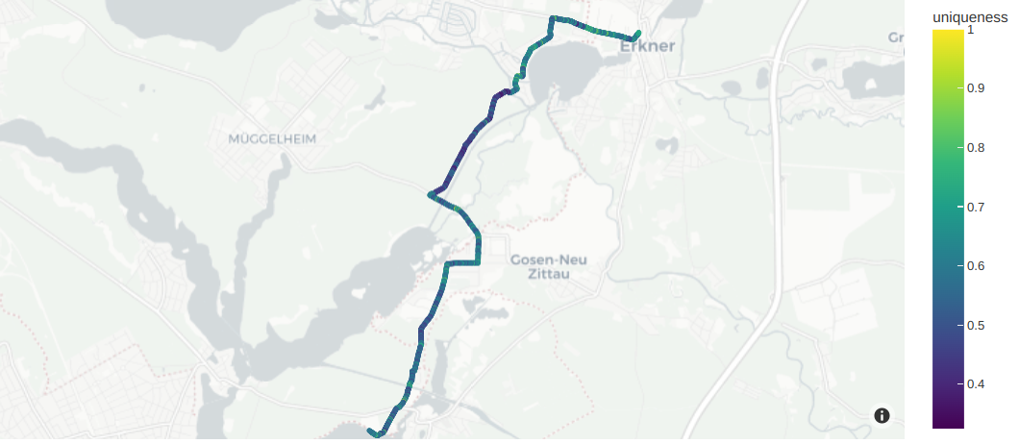
Ⅱ. Project Progression - Fiftyone
Uniqueness
Histogram of the uniqueness field
querying datasets by location: location_scatterplot()
‹#›
DCAITI -Projekt

Slide 5
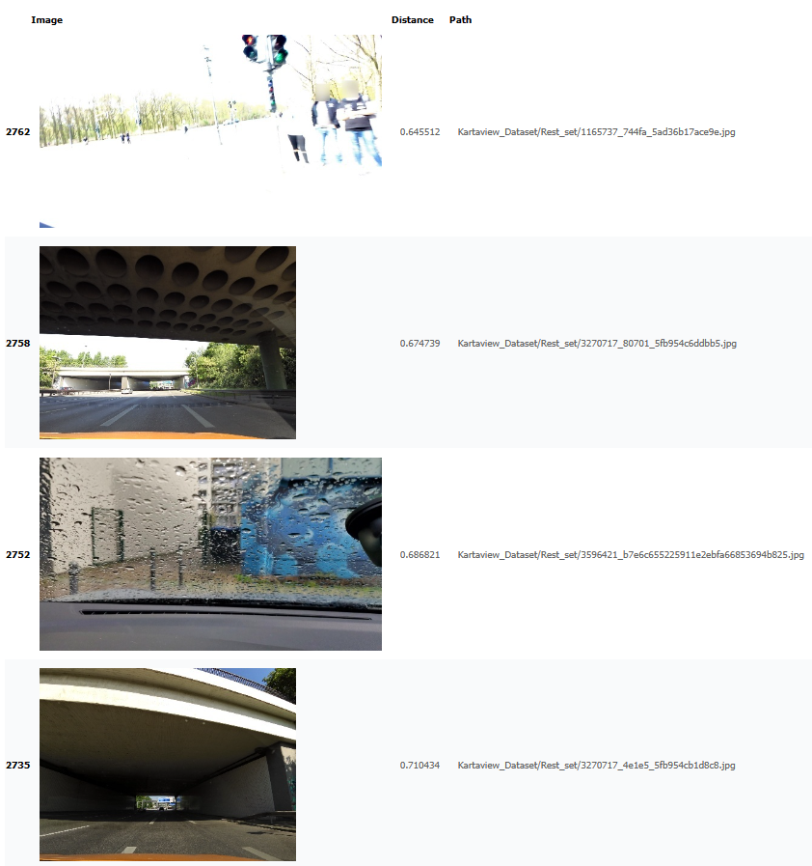
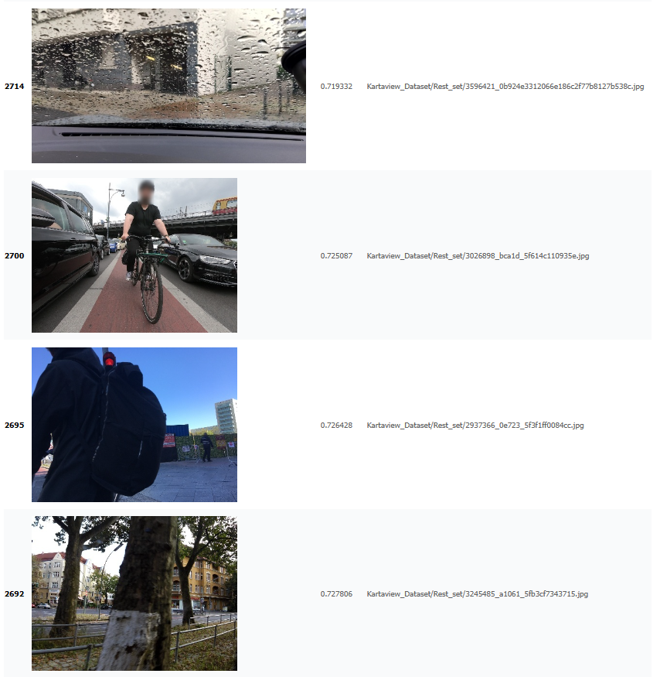
Ⅱ. Project Progression - Fastdup - Outliers
‹#›
DCAITI -Projekt

Slide 6
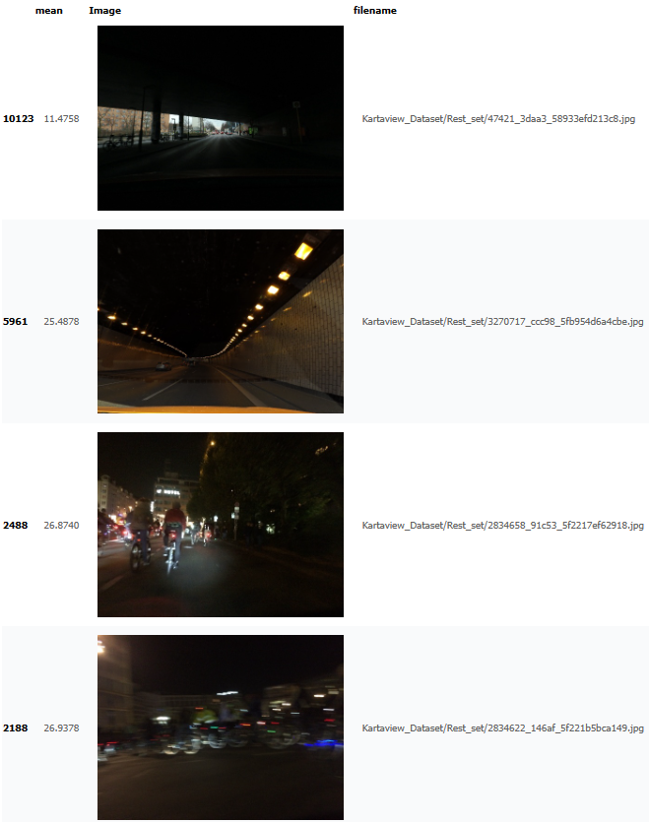
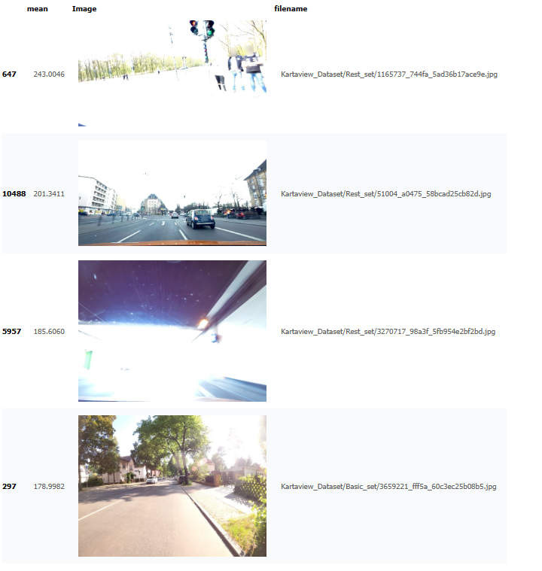
Ⅱ. Project Progression - Fastdup - brightness
‹#›
DCAITI -Projekt

Slide 7
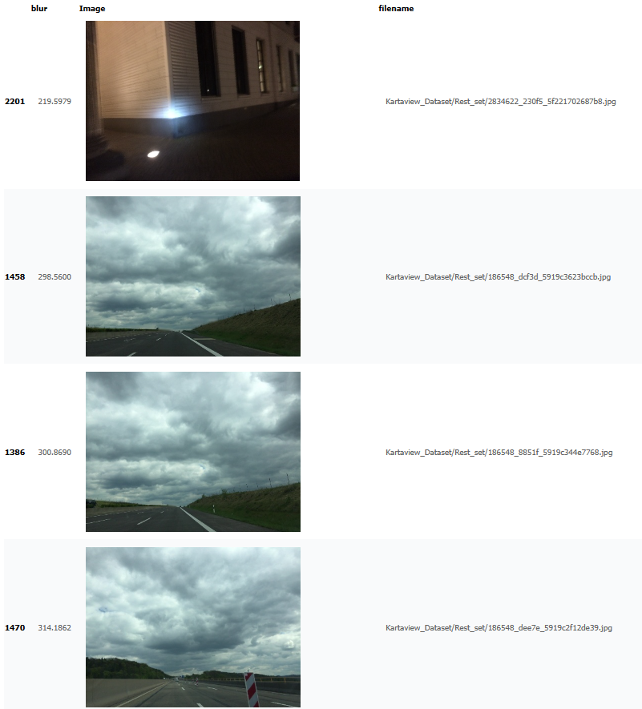
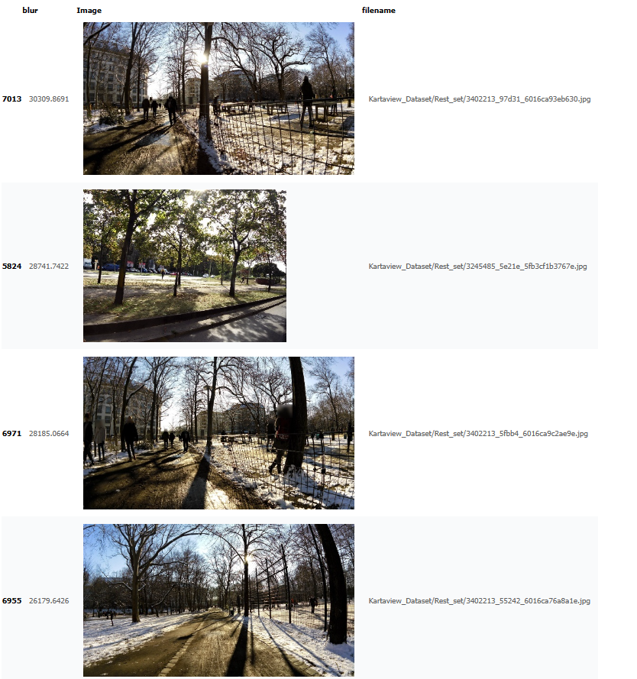
Ⅱ. Project Progression - Fastdup - blur
‹#›
DCAITI -Projekt

Slide 8
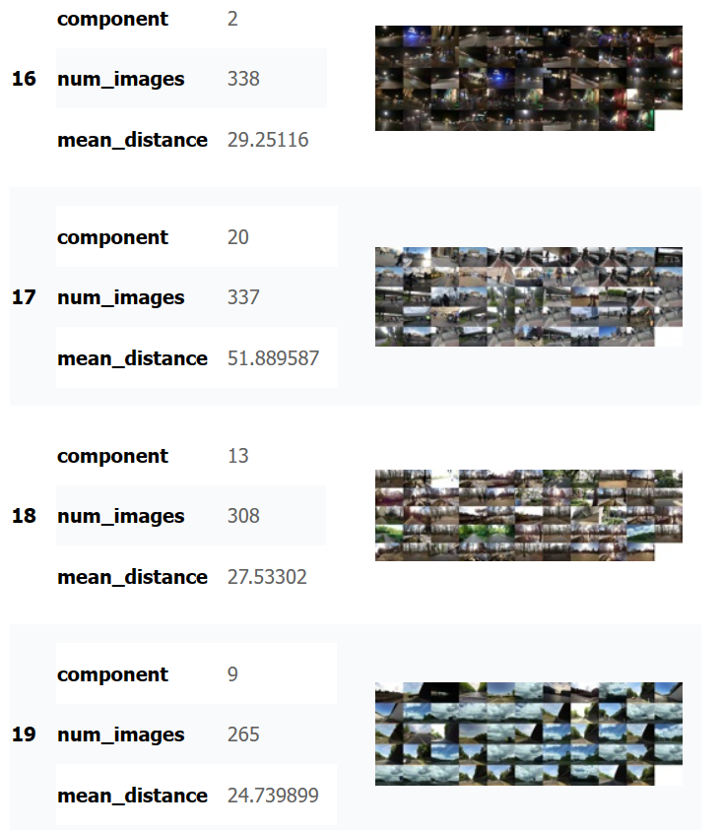
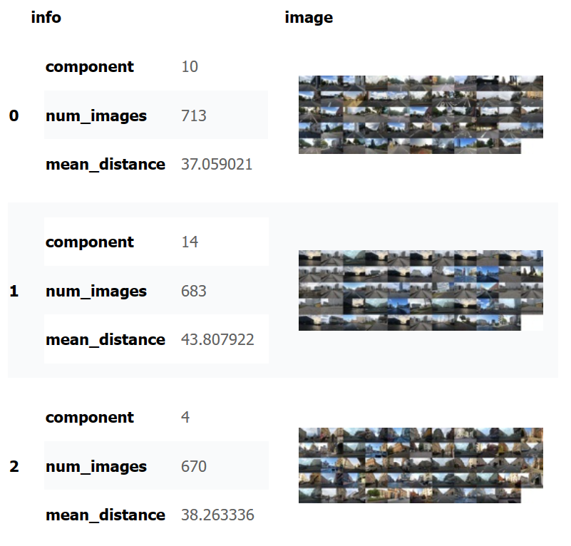
Ⅱ. Project Progression - Kmeans
‹#›
DCAITI -Projekt

Slide 9
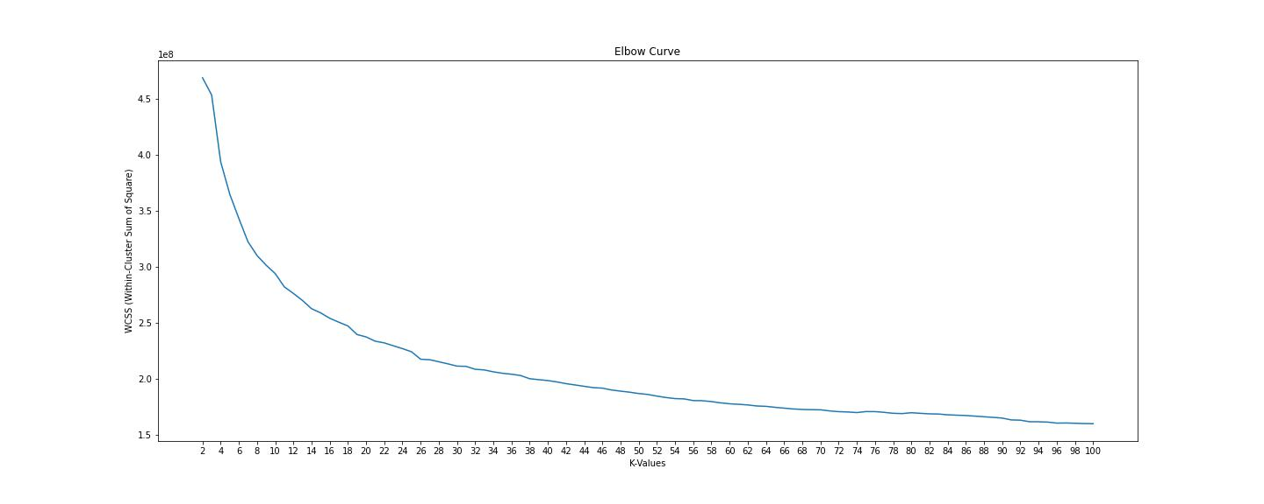
Ⅱ. Project Progression - Kmeans - Elbow Function
‹#›
DCAITI -Projekt

Slide 10
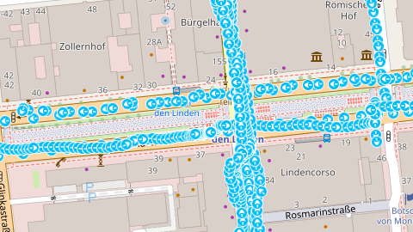
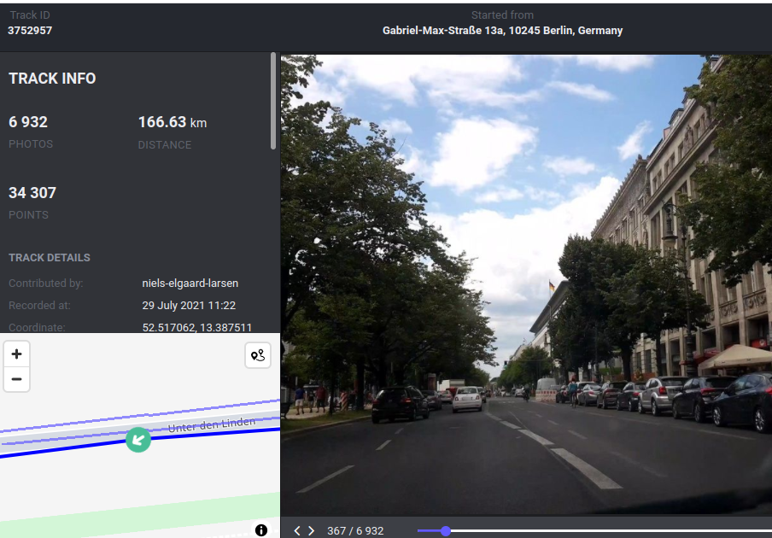
Ⅲ. Current Status - Download Images
11084 images are downloaded
Basic_Set(assumed labeled): 598 images
Rest_Set(assumed to be ranked): 10486 images
from: Java OpenStreetMap Editor
from: Kartaview
‹#›
DCAITI -Projekt

Slide 11
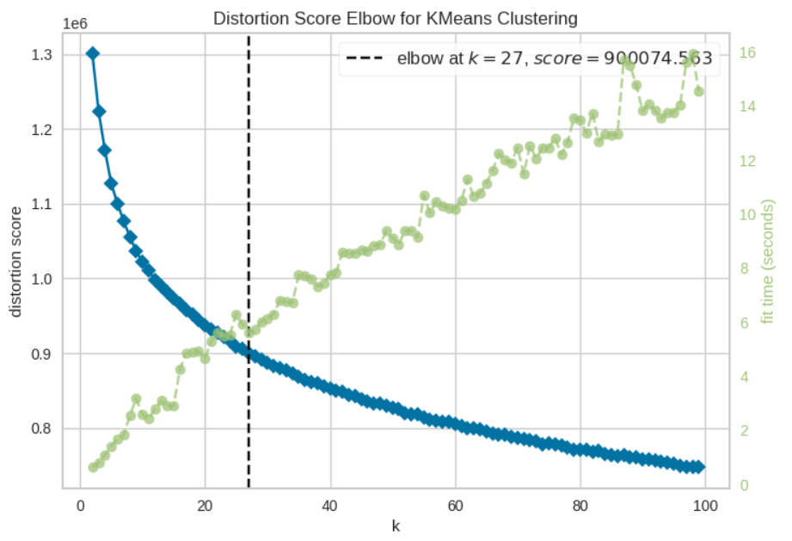
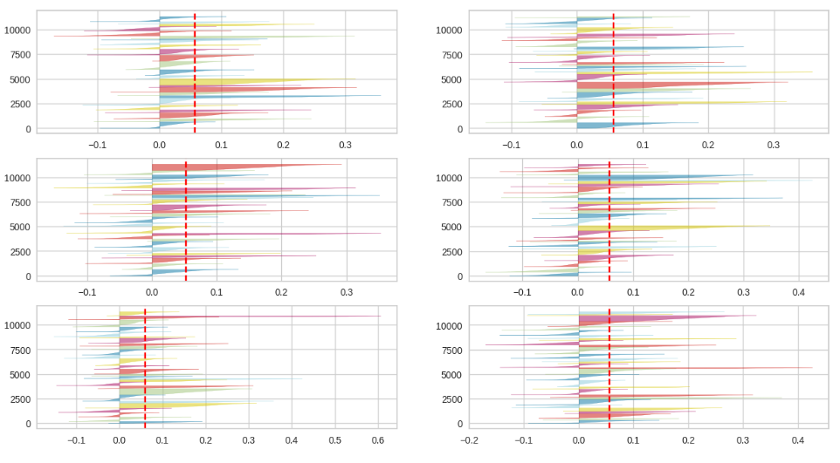
Ⅲ. Current Status - Separate Images
Determination of k
Elbow function:
no obvious elbow point
suggests elbow at 27
Silhouette function:
k: 25-30
average score: 0.05
some clusters’ score: negative
k=26
smaller negative values
average positive values
Elbow result
Silhouette result
‹#›
DCAITI -Projekt

Slide 12
Ⅲ. Current Status - Define Parameters and Weights
fiftyone.brain.compute_uniqueness()
only use pixel data
score:1-0
Score = ( uniqueness * uniqueness_punishment
+outlier_weight * outlier_distance
+similar_weight * similar_distance
+blur_weight * blur
+brightness_weight * brightness )
create_similarity_gallery() from fastdup
in each similar group only one image’s score as 1 and the rest as 0.5
create_outlier_gallery() from fastdup
used to find out which unlabeled images are similar to labeled images
weight:-1 or 0
create_stats_gallery() from fastdup
‹#›
DCAITI -Projekt

Slide 13
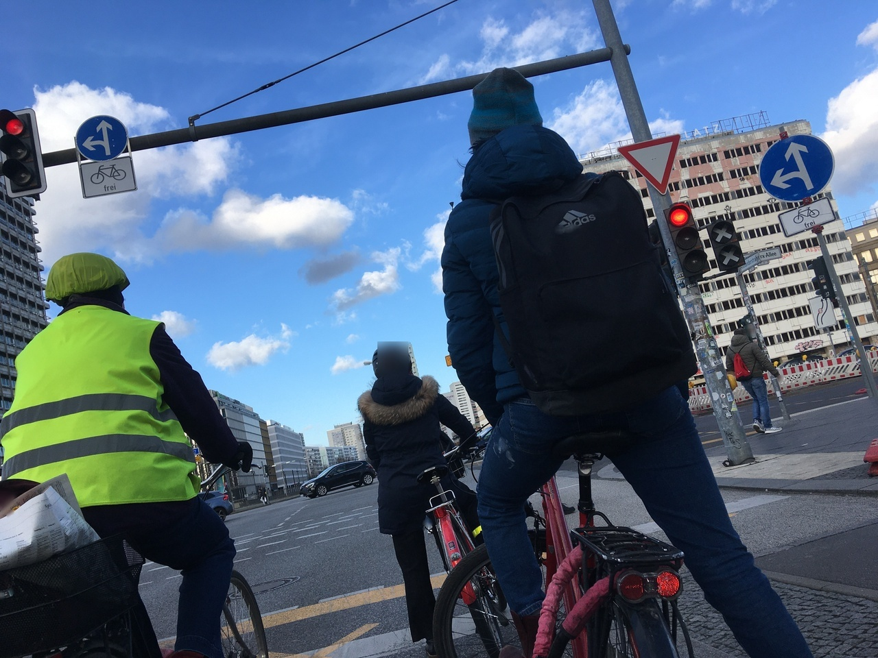
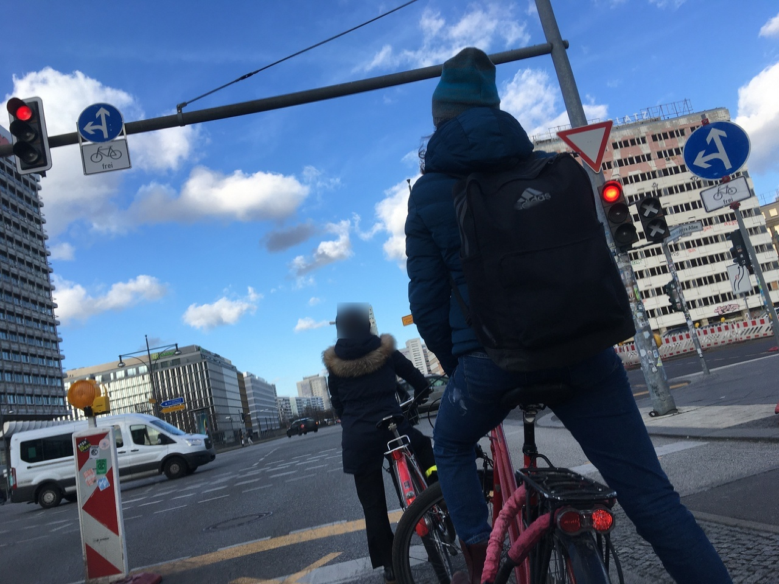
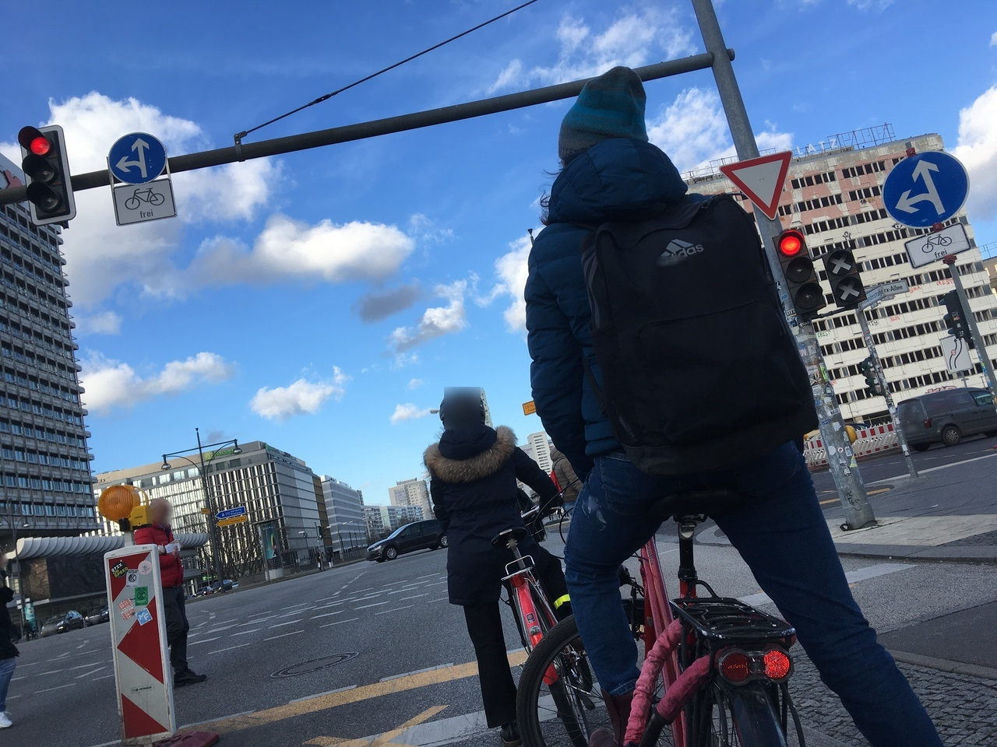
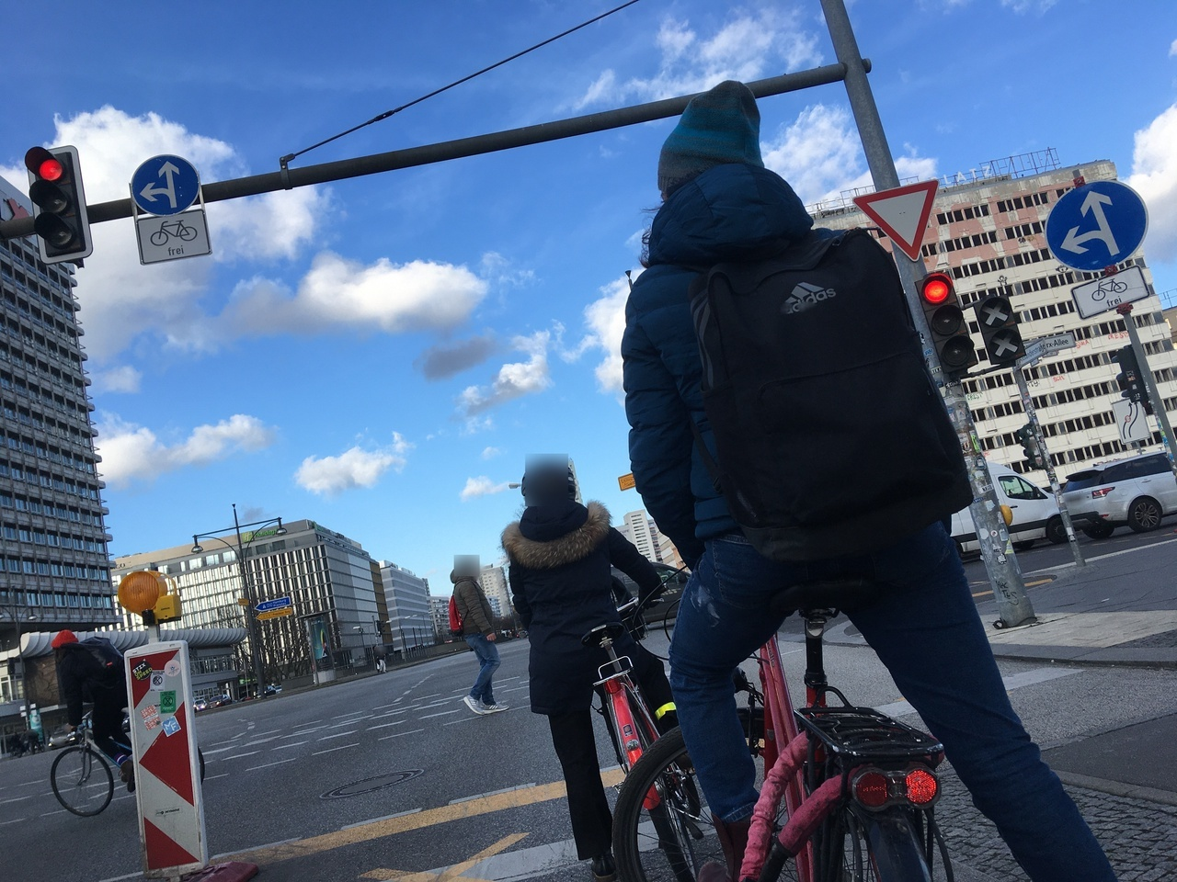
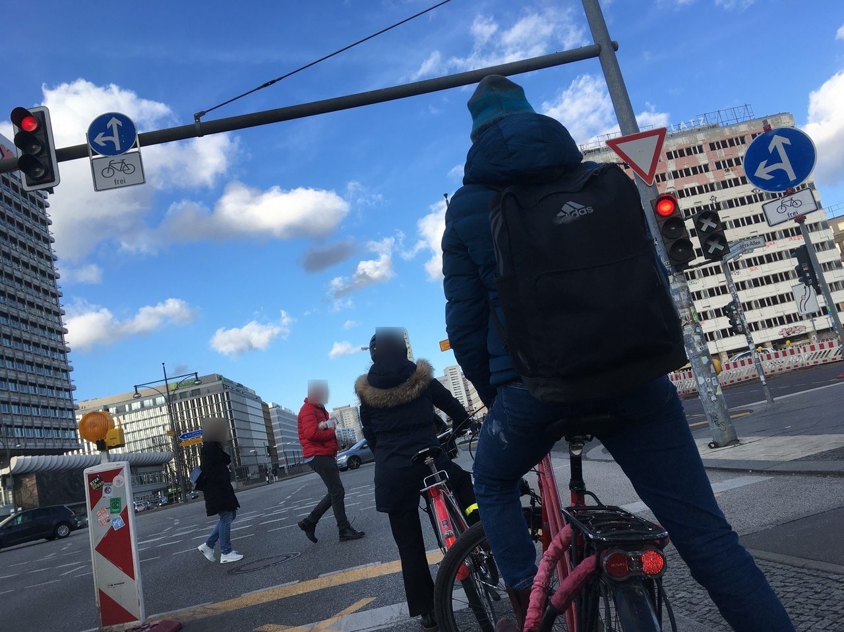
Ⅲ. Current Status - Define Parameters and Weights
uniqueness_punishment: only one image’s score as 1 and the rest as 0.5
‹#›
DCAITI -Projekt

Slide 14
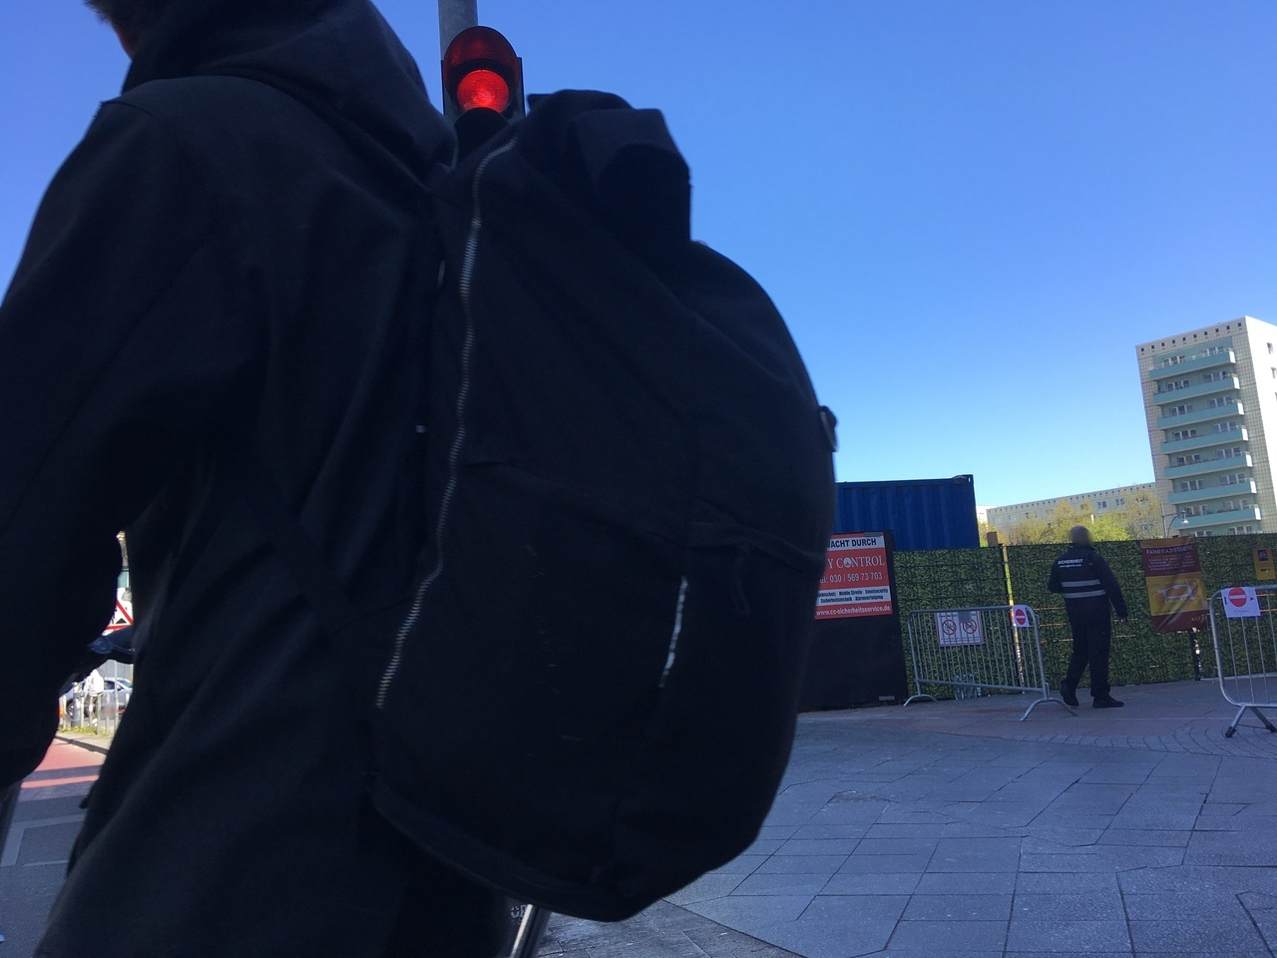
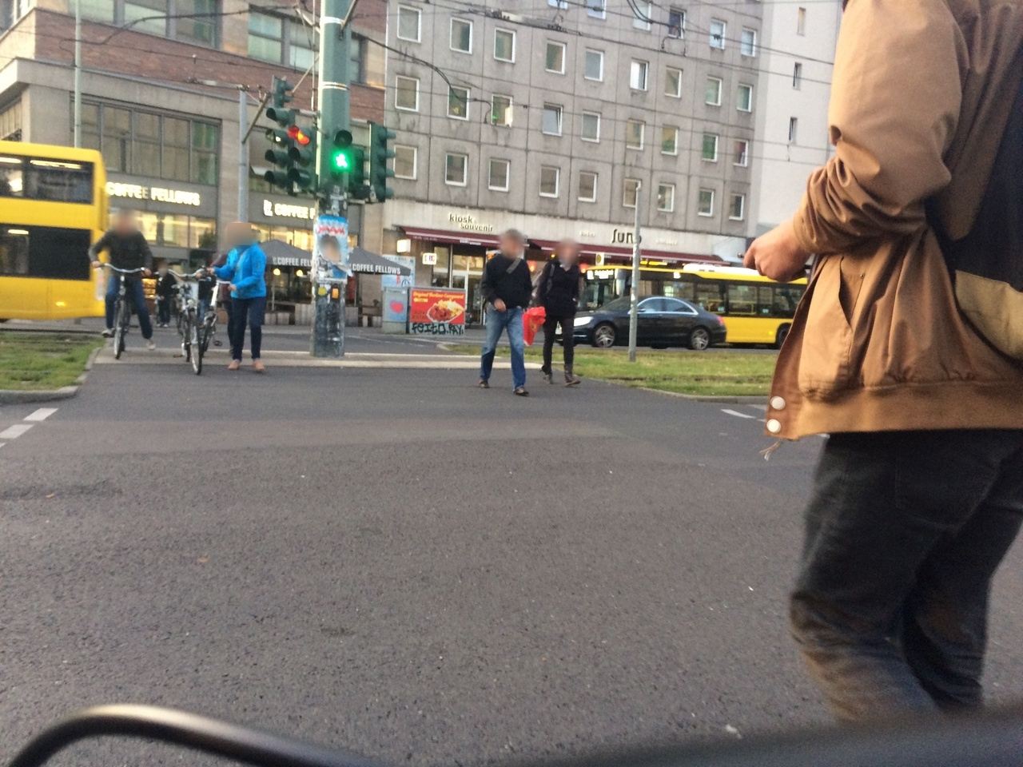
Ⅲ. Current Status - Define Parameters and Weights
A unique image might also be an outlier
Bad Example:
Good Example:
Uniqueness score: 0.742134269863697
Outlier distance: 0.727054
Uniqueness score: 0.55773686681879
Outlier distance: 0.758545
‹#›
DCAITI -Projekt

Slide 15
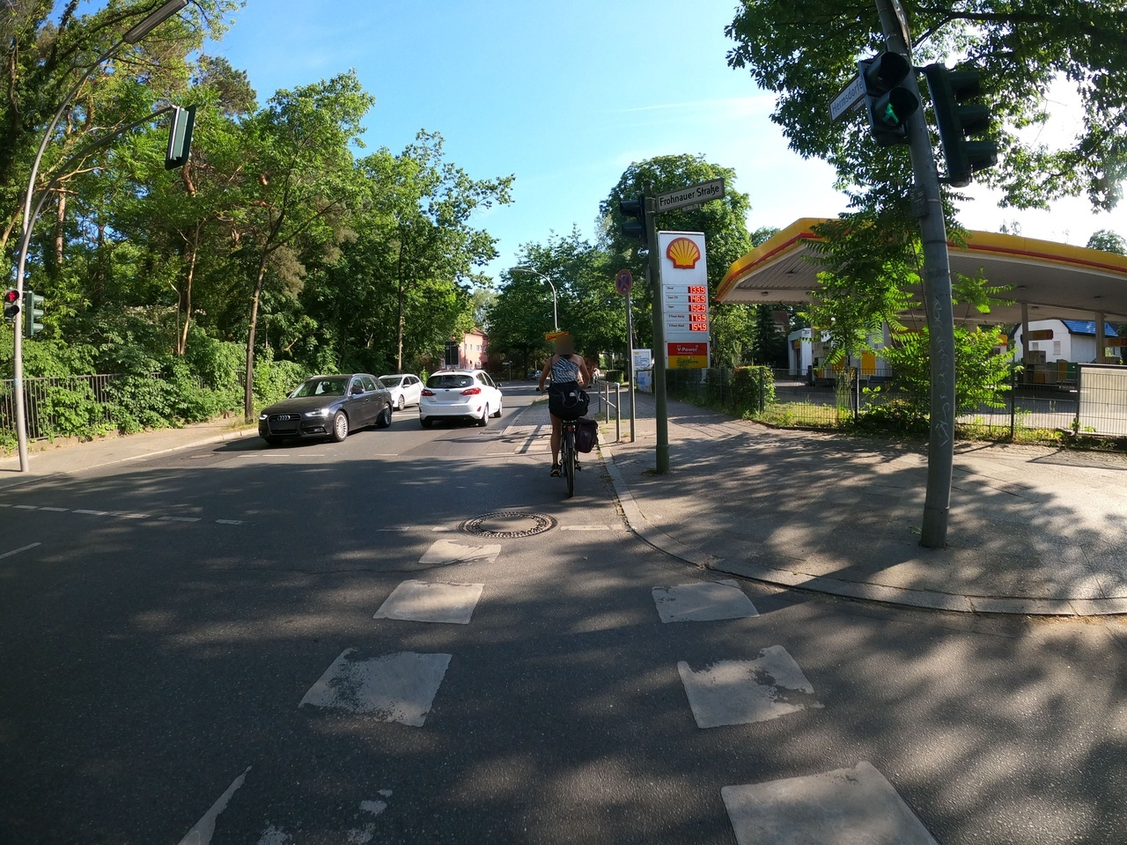
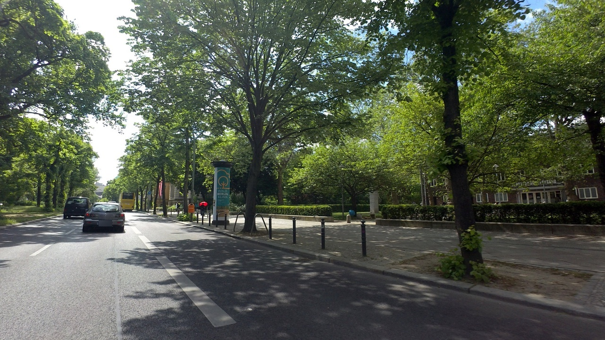
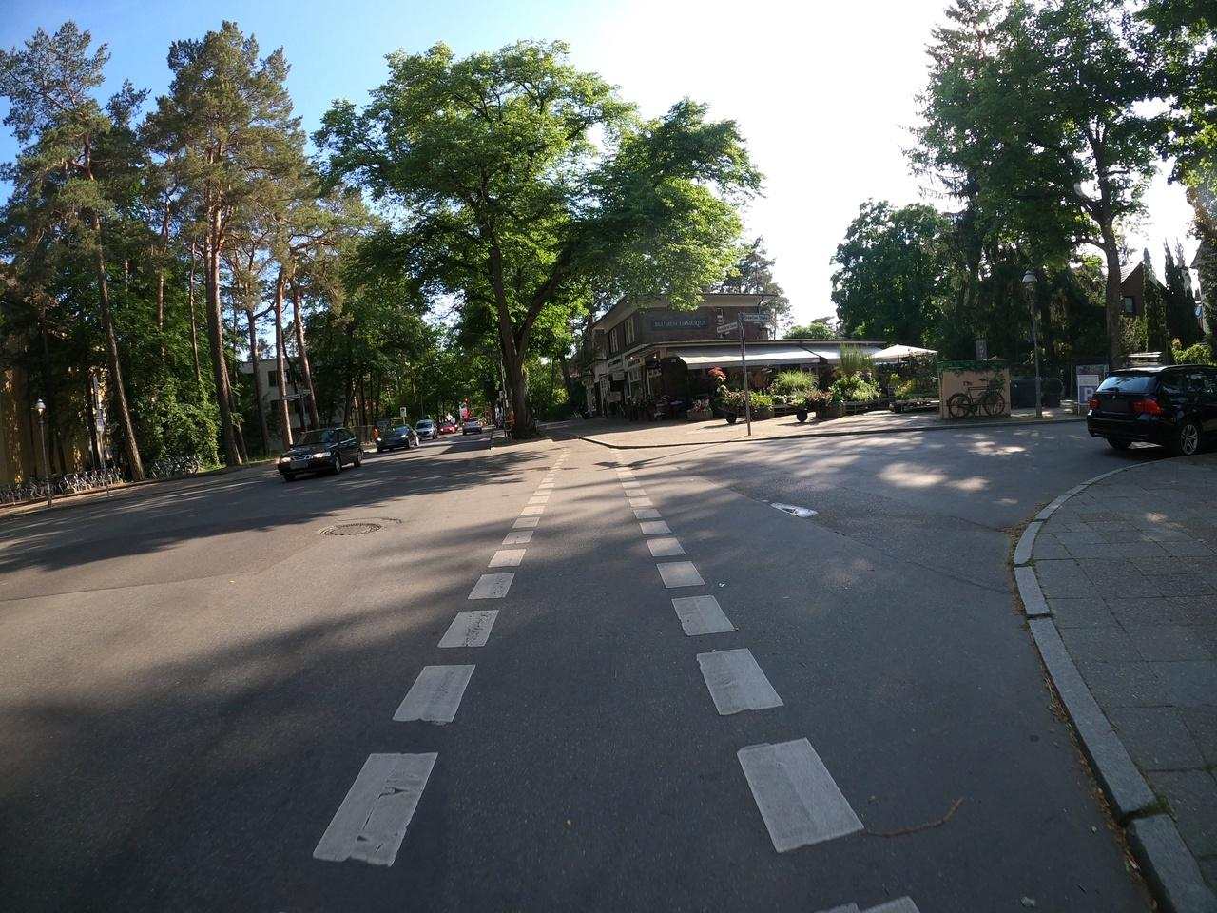
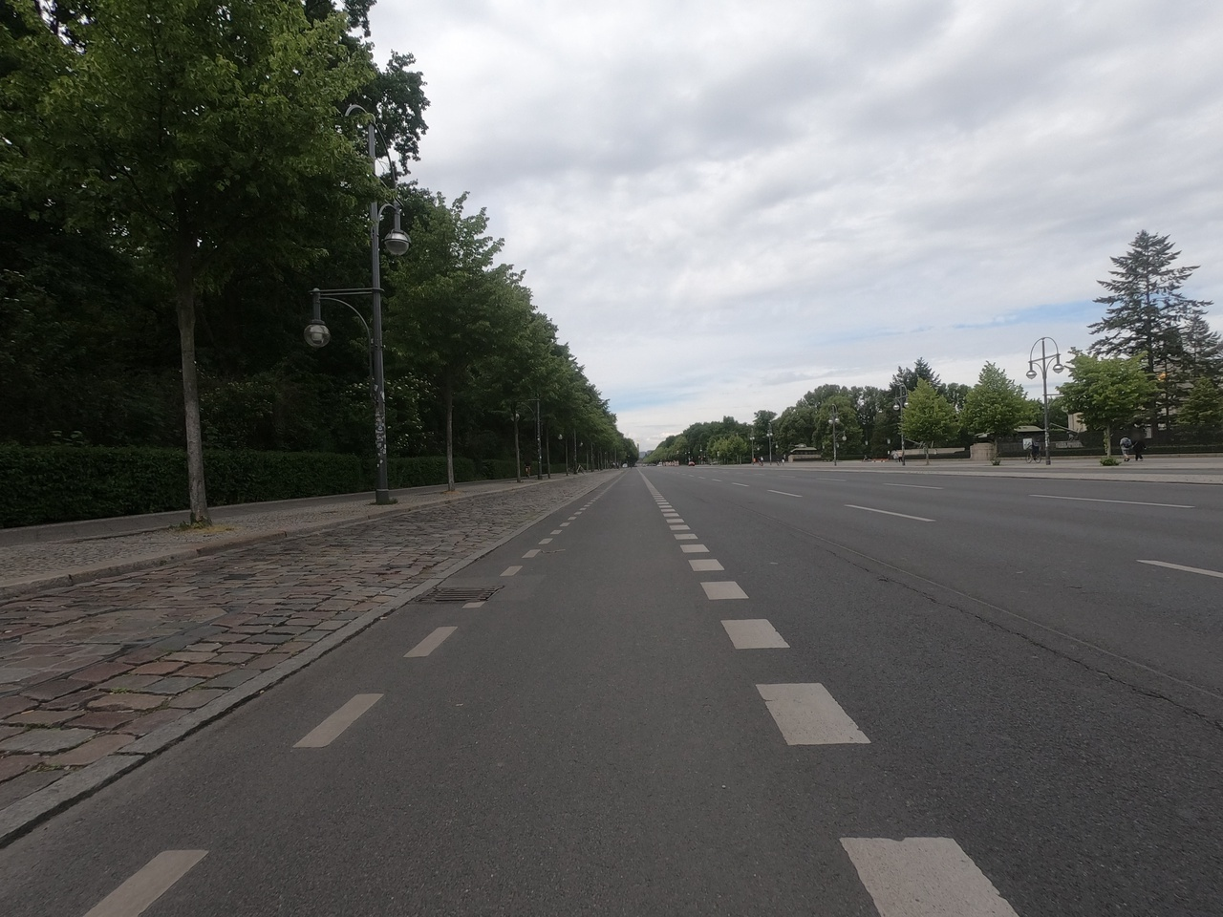
Ⅲ. Current Status - Define Parameters and Weights
Unlabeled images that are similar to labeled images
Labeled:
Unlabeled:
Similar distance: 0.916657
Similar distance: 0.918415
‹#›
DCAITI -Projekt

Slide 16
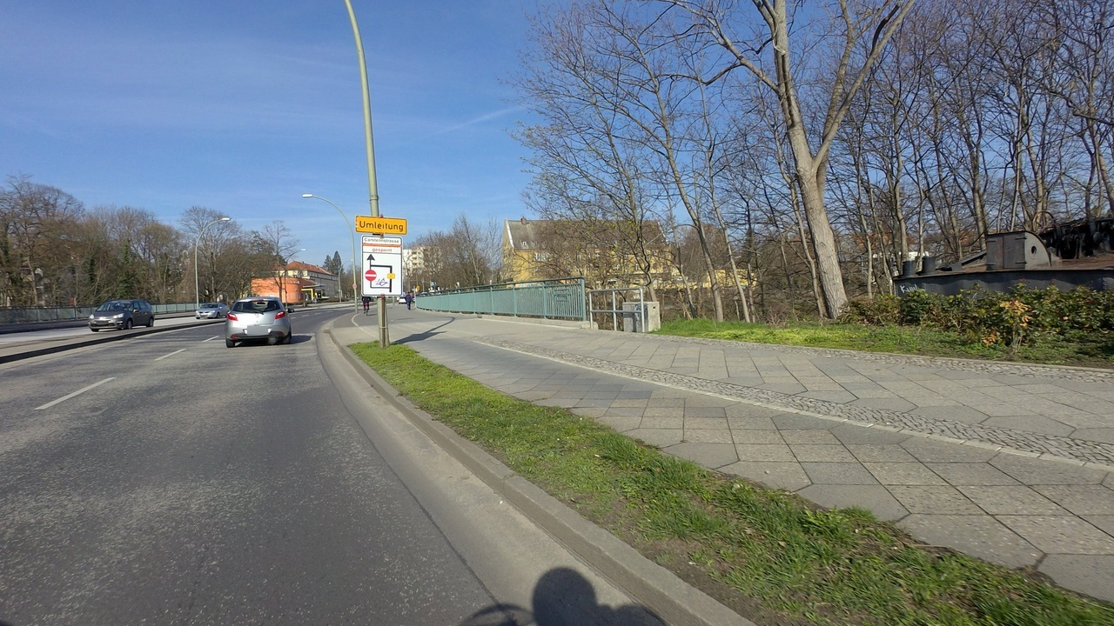
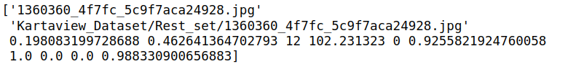
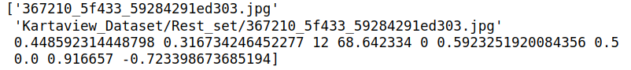
Ⅲ. Current Status - Rank based on Cluster Priority and Score
Cluster Priority
1: Cluster has no labeled images
2: Cluster has a few labeled images (number < 10 and percent < 3%)
3: Cluster has some labeled images (number < 50 and percent < 30%)
4. Cluster has a lot of labeled images
Score
good score(>0.8): 580 images
medium score(0.8-0.2): 9220 images
bad score(<0.2): 686 images
‹#›
DCAITI -Projekt

Slide 17
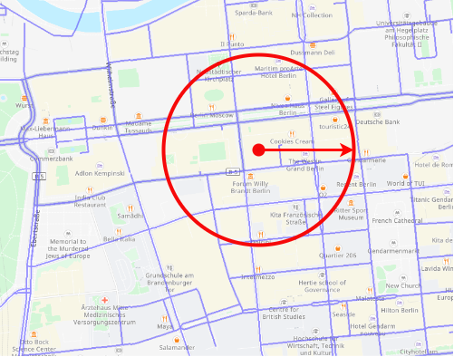
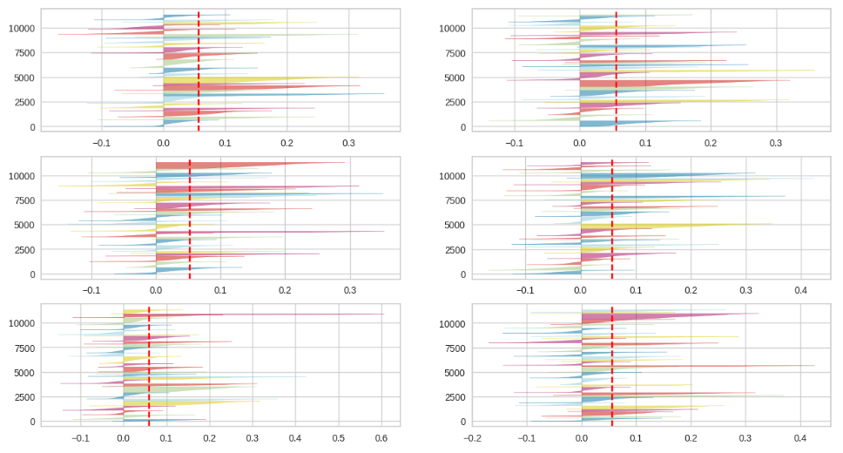
Ⅳ. Outlook
Download Images
combining coordinates and ranges
Separate Images
samples are close to the decision boundary of the neighboring clusters
Define Parameters and Weights
no standard criteria
different parameters and weights for different datasets
‹#›
DCAITI -Projekt

Slide 18
Thank you for your attention
Yiwei Diao yiwei.diao@campus.tu-berlin.de
Yilei Chen yilei.chen@campus.tu-berlin.de
Betreuer: Jens Pontow

